Slide 1

Department of Studies
in Computer Science
University of Mysore
Manasagangothri, Mysore
Computer Networks
ARPANET
BY:
Mohammad Reza Sharifi
19MS20

Slide 2
ARPANET
It is abbreviated as “Advanced Research Project Agency Network
In mid 60’s, Department of Defense (DoD) started ARPANET to build a network that could resist any attacks from USSR and Help academicians (professors & students) share research.
* USSR: Union of Soviet Socialist Republics

Slide 3
ARPANET
It was in response to USSR’s Sputnik launch in 1957.
It connected 4 major universities: –
University of California (@Los Angles) – University of California (@Berkeley) –
University of Utah –
Stanford Research Institute
Sputnik 1: Satellite-1 launched by USSR

Slide 4
ARPANET
ARPANET used the packet-switching technology to interconnect four nodes. Hence DoD divided the network into subnets & host computers.
Subnet would consist of minicomputers called “Interface Message Processors” (IMPs) connected by transmission lines.
For high reliability, each IMP would be connected to at least 2 IMPs.

Slide 5
ARPANET
Even if some IMPs or lines were damaged, the network still worked for others. Each node of the network was to consist of an IMP and a host, in same room connected by a short wire.
A host could send messages up to 8063 bits to its IMP, which would break these into packets of at most 1008 bits and forwards them independently towards the destination. Each packet was received fully before forwarding to next hop.

Slide 6
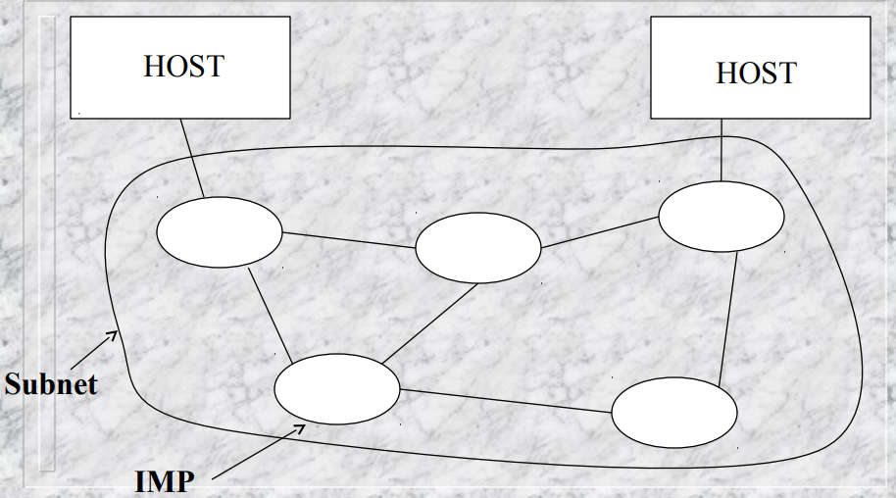
Figure of ARPANET
The software was needed between IMPs to provide communication.
Also, software was needed to provide host IMP, user-host & host-host communication. This model of ARPANET expanded to 8 nodes, then 15 nodes and so on expanded to form today’s Internet.

Slide 7

By:
Mohammad Reza Sharifi
19MS20

